Slide 1
Slimming Paint
Notes:
S

Slide 2
tl;dr
Cache recordings
Layerize in cc
Why?
Re-recording is expensive
Blink shouldn’t do layers
Notes:
S

Slide 3
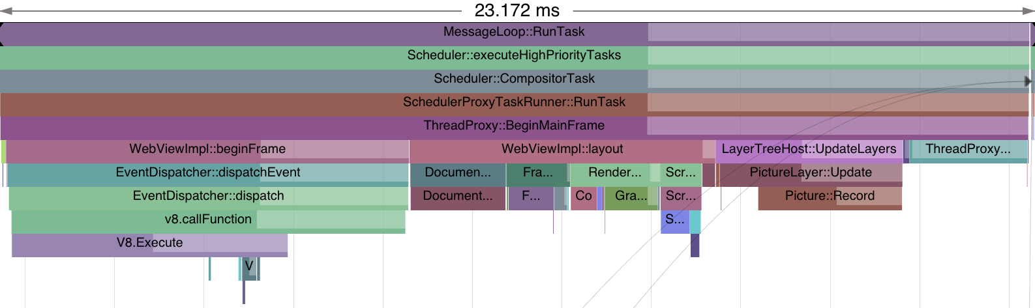
From Content to Pixels
Too much fat, and backwards
Network and Parser
DOM
Style
Layout
Compositor Setup
Record Painting
Notes:
S

Slide 4
Painting is too expensive
Issuing draw calls should not take longer than style and layout!
Notes:
S

Slide 5
Project Goals
Faster recording/painting
Correct and faster compositing
Healthier, better tested code
Notes:
S

Slide 6
Painting Bottlenecks
Expensive layer management
Blink paint code not optimized for our compositor architecture nor Skia
Inherited 2 code paths: CG/CA & Skia/cc
We cache pixels, repeat work to define them
Notes:
S

Slide 7
Potential for re-use
On basic interactions, we repaint the same thing multiple times
Images, for example, do not change on about 80% of their calls
Image overlaps some changed rect, but it is not itself damaged
Notes:
S

Slide 8
Compositing Limitations
RenderLayer is the compositing “atom”
Causes “fundamental compositing bug”
Prevents layers in SVG
Layer layering violation
Squashing was forced to be a retrofit
Notes:
I

Slide 9
Fundamental Compositing Bug
Notes:
I

Slide 10
Fundamental Compositing Bug
Composited
No RenderLayer
To be composited
Notes:
I

Slide 11
Fundamental Compositing Bug
Composited
Uh oh!
No RenderLayer
Composited!
Notes:
I

Slide 12
Example: Incorrect compositing
Courtesy of esprehn:
<canvas id="canvas"
style="background:red;...">
</canvas>
<div id="overlap"
style="background:green;margin-top:-50px;...">
</div>
Notes:
I

Slide 13

Example: Incorrect compositing
Notes:
I

Slide 14
Example: Incorrect compositing
Why is red on top?
canvas got own backing
Has its own RenderLayer
div didn’t
Shares body RenderLayer
Notes:
I

Slide 15
Example: Incorrect compositing
Why?
Since green had no RenderLayer,
It didn’t participate in overlap detection, and
Even if we wanted to promote it, we couldn’t!
Notes:
I

Slide 16
Simplify Code
Match code to logical units
CSS painting algorithm in Blink
Graphics layer logic in compositor
Remove Source/core/rendering/compositing
Better hit testing
Rationalize paint phases
Compositing on the right data structures
Notes:
S

Slide 17
Getting to the goal ...

Slide 18
What Code is Affected?
Blink paint
Break painting into its own module
Painting converts render objects to display items
Compositor
Entirely responsible for layering decisions
Rasterizer
Better texture management, GPU targeting
Notes:
S, GPU targeting = we can make layering decisions based on hardware

Slide 19
Top Level Blink Design
Blink paint produces a list of display items
Compositor uses this to layerize and raster
Layers
Paint list
Paint
Compositor
A
B
C
D
Notes:
S

Slide 20
Top Level Design
Previous paint list
A
B
C
D
Paint changes
Updated paint list
Paint
Merge
B
C
E
A
C
D
E
Previous layers
Updated layers
Compositor
Notes:
S

Slide 21
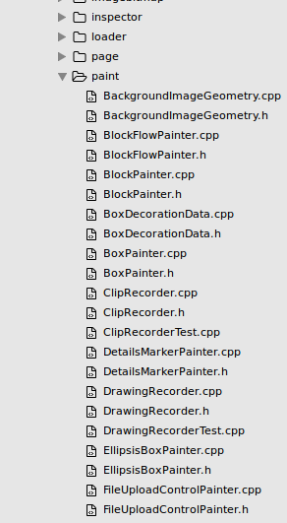
Blink Changes: Painting refactor
Painting code moved out of RenderObject, into Painters
Code will be re-arranged for improved comprehension
e.g. Break out code paths per phase
e.g. Better map CSS paint spec onto code
Notes:
S

Slide 22
Blink Changes: Paint list
All painting data inserted into a list of DisplayItem
Drawing commands, clips, transforms, stacking, …
Only invalid renderers create new data
Post-paint update merges new items with existing
Notes:
S

Slide 23
Paint list example
<div style=“clip: rect(...); bg-color: papayawhip;”>
<happy></happy>
</div>
Begin Clip
Fill Rect
Draw
Happy
Background
Draw
Happy
Foreground
End Clip
Notes:
S

Slide 24
Blink Changes: Future
Remove GraphicsLayer, CompositedLayerMapping, etc
These structures are Blink’s attempt to set up compositing, but the compositor knows more about compositing
Remove RenderLayer
Reduce to hints in the paintlist.
Notes:
S

Slide 25
Compositor Change: Replace CDP
CalcDrawProps walks the layer tree
Recursively computes visible rects, clips, screen-space transforms, screen-space opacity
Compute from tiny property trees instead
Intuition: # of “significant” transforms, clips, or filters is << total # of layers
Notes:
I: In fact, we won’t really have a “composited layer tree” any longer, just a list of layers + tiny property trees.

Slide 26
Compositor Change: Layerization
Layerization = clump draw ops in layers
Historically: done in Blink with RenderLayers
Now: done by the Compositor
using hints sent by Blink, knowledge of hardware
A
B
C
D
E
F
A
B
C
D
E
F
Hint1
start
Hint2
start
Hint2
end
Hint1
end
Layer 1
Layer 2
Layer 3
Notes:
I: The picture leaves out squashing (we can squash together Layer 3 and Layer 1 if Layer 3 doesn’t overlap Layer 2).

Slide 27
Compositor Changes: Future
Might move other consumers to display lists
Notes:
I

Slide 28
Measuring Success
Improve frame time
Particularly in dynamic situations
Composite more content, GPU more content
Telemetry tests
Reduce bug count
Things we can’t fix now
Fewer bugs in the long run
Increase developer productivity
Notes:
S

Slide 29
Related Projects
TextBlobs: Compute text paint information once, pass all the way to Skia
GPU Rasterization (Ganesh): Draw all content with the GPU
Also reduce code, texture consumption, etc
Various other perf projects
Notes:
S

Slide 30
People
Blink
Compositor
Chris Harrelson (chrishtr)
pdr
leviw
schenney
trchen
Ali Juma (ajuma)
vollick
enne
weiliangc
awoloszyn
Notes:
S

Slide 31
Following Along
silk-dev@chromium.org mailing list for Silk Project development info
slimming-paint-reviews@chromium.org for code reviews
Slimming Paint Overview document
Slimming Paint wiki (go/slimming-paint)
Notes:
S

